Slide 1
Real-Time Consumer Behaviour Prediction
and
Targeted Marketing Approach
Alvin Chua

Slide 2

BUSINESS PROBLEM: INCREASE CONVERSION RATE / REVENUE

Slide 3
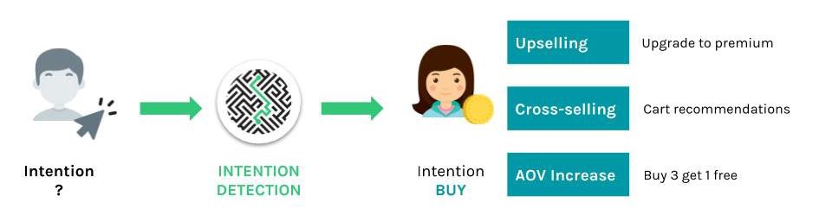
INTENTION TO BUY

Slide 4
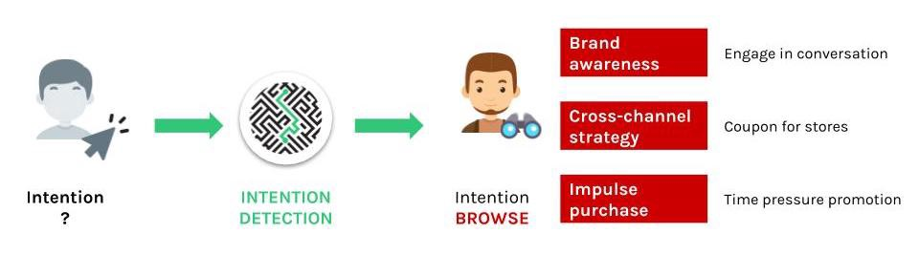
INTENTION TO BROWSE

Slide 5
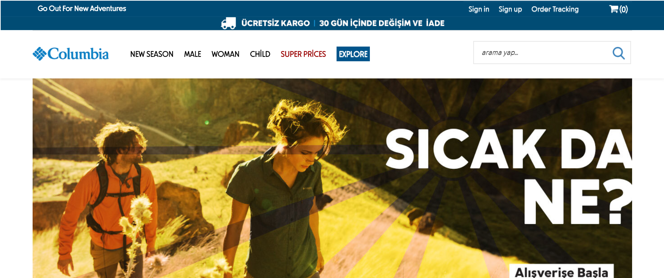
DATASET

Slide 6


DATASET SOURCE
Google Analytics data
12,330 sessions (rows) from different users

Slide 7
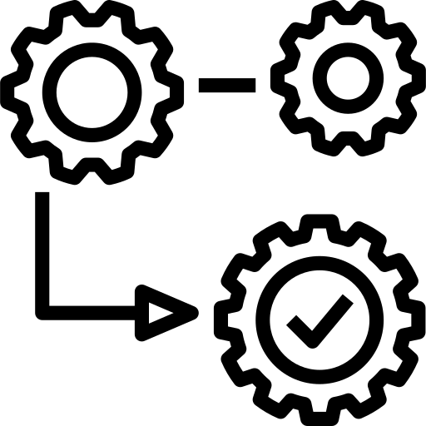






FEATURE DESCRIPTION (NUMERIC)
Administrative
Page Clicks
Duration (sec)
Informational
Page Clicks
Duration (sec)
Product-Related
Page Clicks
Duration (sec)
Special Day
Page Value
Bounce Rate
Exit Rate

Slide 8



FEATURE DESCRIPTION (CATEGORICAL)
Month
Visitor Type
(New, Returning, Others)
Weekend
(Yes/No)

Slide 9




MASKED FEATURES (CATEGORICAL)
OS
(8 types)
Browser
(13 types)
Region
(9 types)
Traffic Type
(20 types)

Slide 10
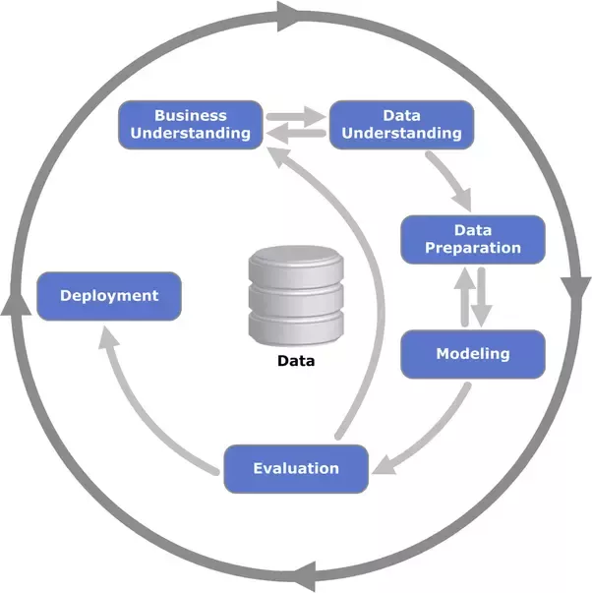
DATA SCIENCE PROJECT WORKFLOW

Slide 11
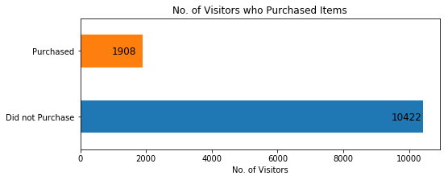
TARGET VARIABLE

Slide 12
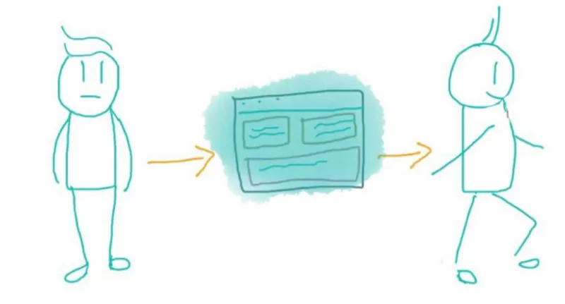
BOUNCE RATE
enters website, and leaves from landing page, without visiting anything else

Slide 13
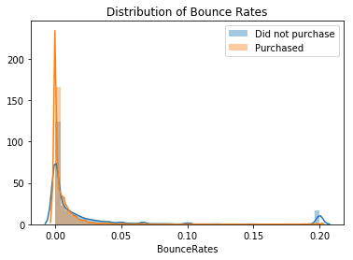

Slide 14
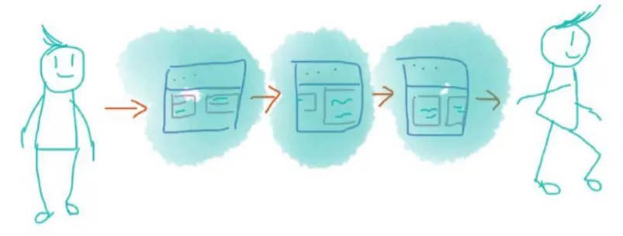
EXIT RATE
percentage of visitors who click away to a different site from a particular page, after having visited any number of pages on your site

Slide 15
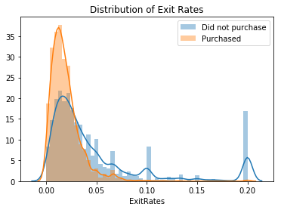

Slide 16
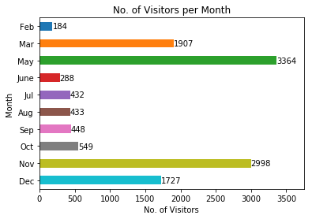

Slide 17
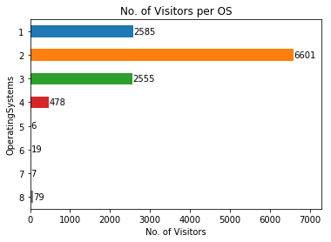




Slide 18
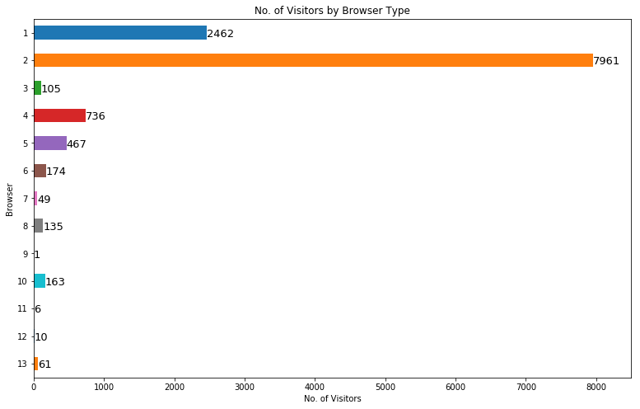



Slide 19
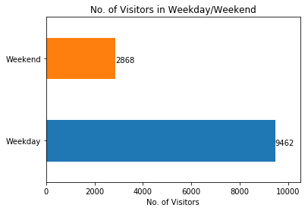

Slide 20
WORKFLOW
Feature Engineering
Data Preprocessing
Modelling

Slide 21

MODELLING

Slide 22

MODEL SELECTION
Compared scoring metrics across 9 different classification models
Chose XGBoost as final model
Highest F1 score: 66.8%
Highest Recall: 72.0%
Highest ROC AUC: 82.0%

Slide 23
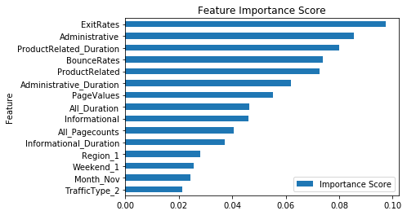
FEATURE IMPORTANCE

Slide 24
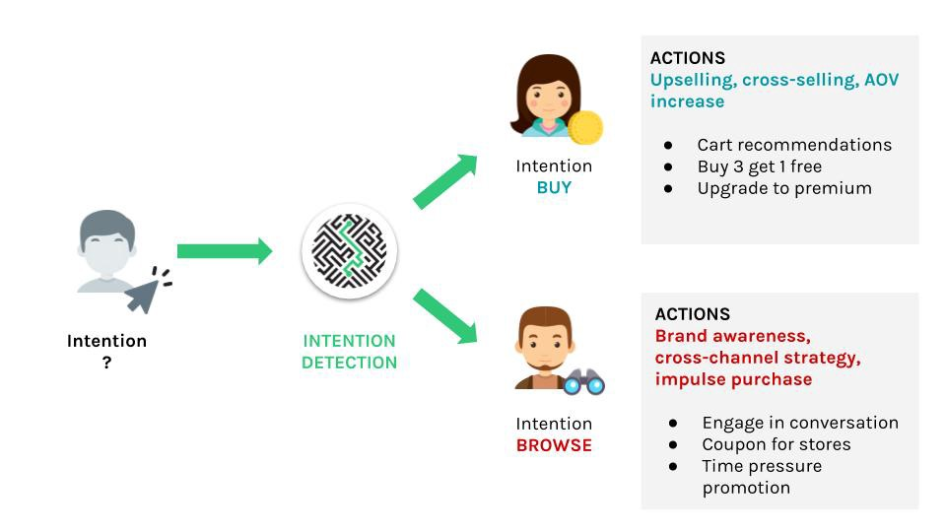
BUSINESS IMPACT
 | Predicted Non-Purchase | Predicted Purchase
Actual Non-Purchase | 1919 | 165
Actual Purchase | 109 | 273

Slide 25
LIMITATIONS
Highly masked data
Lack of geographical data
Lack of domain knowledge (marketing)
Some columns are aggregated (Google Analytics data)

Slide 26



LIMITATIONS
Highly masked data
Marketing knowledge
Aggregated
Google Analytics data

Slide 27
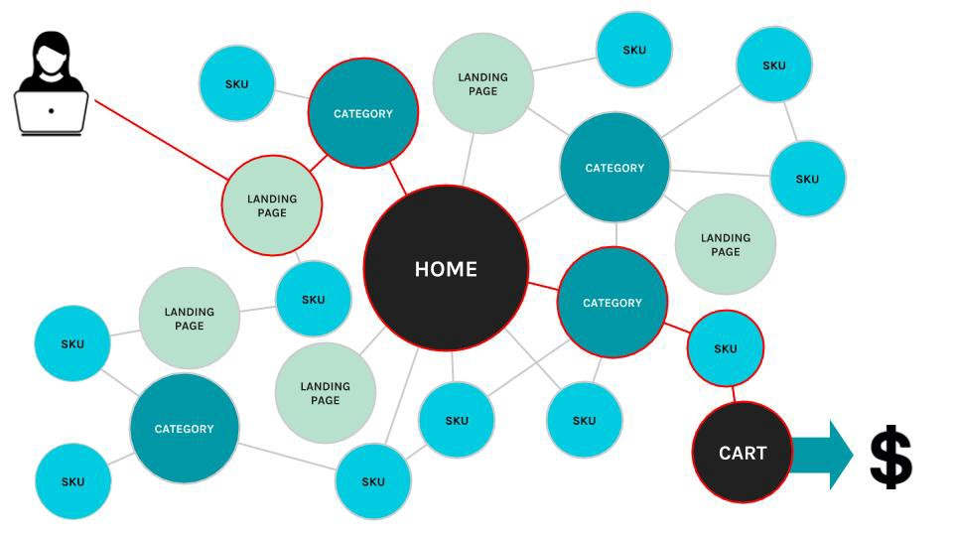
NEXT STEPS
Shopping cart abandonment problem
Request for more data from research professors

Slide 28


NEXT STEPS
Optimise current model
Possible model deployment

Slide 29
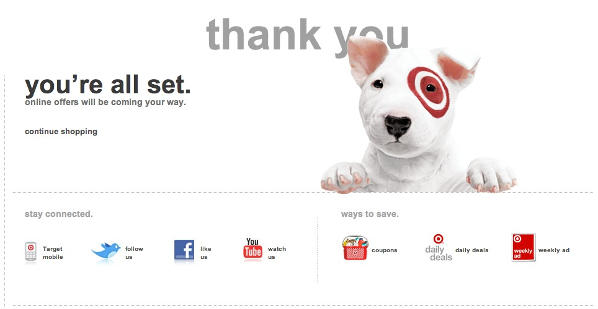
ANY QUESTIONS?

